Slide 1
E-Commerce Churn Analysis
Maria Sohail – Jack of all trades
Eunice Worifah – jack of all trades
Notes:
Hi Everyone!

Slide 2
TABLE OF CONTENTS
01
02
03
04
Background
Hypothesis
Data and Modelling
Results and Conclusion

Slide 3
01
Background

Slide 4
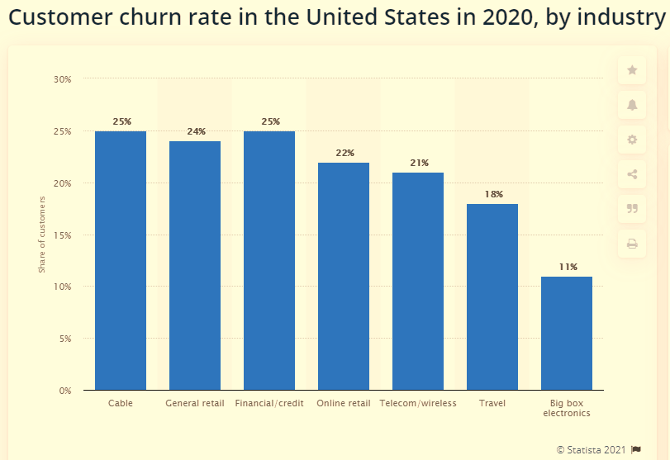
What is Churn?
Customer churn is when customers stop doing business with an entity.
Subscription – customer does not renew their subscription -
*Non-Subscription - customer gradually reduces their purchase frequency over time, or may all of a sudden never buy again
Notes:
Customer Churn is….
In subscription based e-commerce models (like Amazon Prime), churn occurs when a customer does not renew their subscription.
In Non-Subscription based models (like normal Amazon), this occurs when the customer gradually reduces their purchase frequency over time, or may all of a sudden never buy again. This churn is trickier to measure and it is what our analysis is based on today.
In 2020, in the US the average churn rate in the Online Retail industry was 27%. Our dataset has a 20% churn rate, so it is less than industry average, but still a significant issue that should be addressed

Slide 5
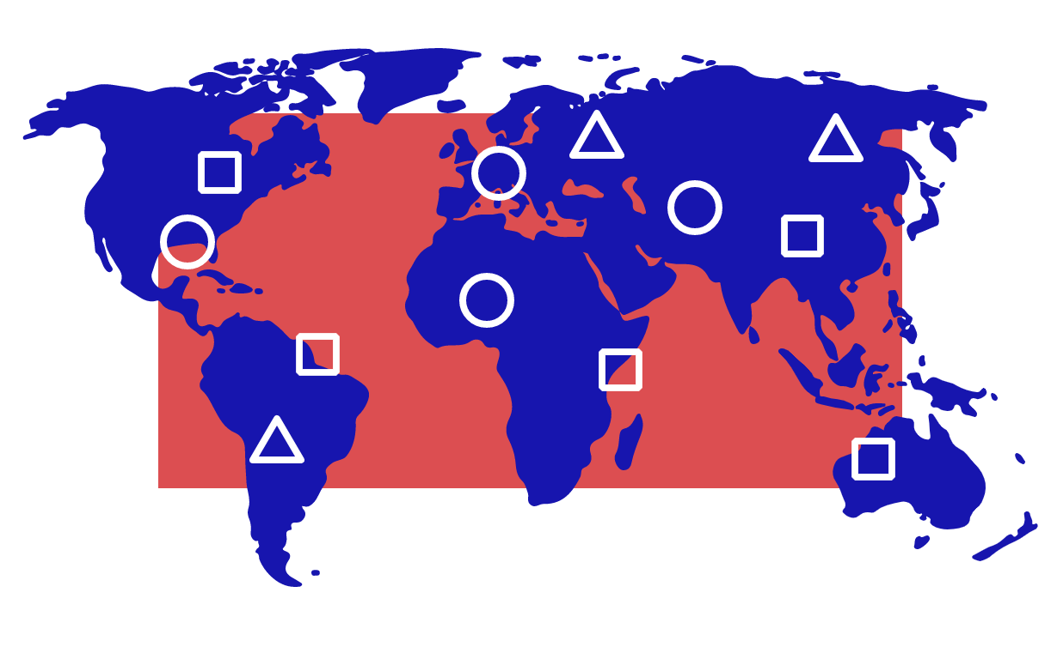
Why Does this matter?
E-Commerce is slowing becoming the dominant distribution channel
Retail sales from worldwide e-commerce are forecast to grow to over 6.54 trillion in 2023.
Revenue generated within the retail e-commerce market is expected to surpass 33 billion U.S. dollars by 2024, up from 25.4 billion in 2019.
In late 2019, e-commerce retail trade sales amounted to almost 1.85 billion Canadian dollars, with approximately 28.1 million Canadians having made purchases online.
Notes:
In the era of E-commerce, churn rate is an important indicator, and could signal something problematic with your business model or product features.

Slide 6
Stakeholders
COMPANY
Shareholders - Revenue and Profit
Marketing - Advertising and Customer Acquisition
Customer Service - Customer Satisfaction
Logistics - Product Delivery
Product Management - UX/UI
Sales - Customer Acquisition
Customer
Pleasant Experience and High Customer Satisfaction
Notes:
It is important to understand the different stakeholders in the e-commerce business who could benefit from our churn analysis.
There are 2 main stakeholders: The company and the Customer.
Within the company, there are several sub-stakeholders who have their own interests. The insights gained from our analysis can feed into all these elements.
On the customer side, their biggest need is to have a pleasant shopping experience and high customer satisfaction.
Using out analysis, an e-commerce business will be able to gain a preliminary understanding of some of the reasons behind their churn rate, which will allow them to employ the right strategies to increase customer retention. A study by the Consulting Firm Bain showed that a 5 percent increase in customer retention produces more than a 25 percent increase in profit.

Slide 7
Our ObjectiveS
Explore data and understand customer attributes that correlate to a higher risk of churn
Build a model to predict customer churn

Slide 8
02
HYPOTHESIS
Notes:
Our dataset looks at customer data from an e-commerce company such as Amazon where customers create a profile, shop for items on the website, purchase their items through various payment methods and the items are dispatched from a warehouse in or near their city and delivered to the customer. We have data that show the customer behavior within the last one-month period.

Slide 9
We Hypothesize that…
tenure | The longer the customer has been with the company, the less likely they are to churn.
Complain | If a customer lodged a complaint within the last month, this increases their likelihood to churn.
Cashback amount | The greater the cashback amount, the less likely a customer is to churn
Accessing app by phone | Customers who prefer to use the app on their mobile phone are less likely to churn compared to customers who prefer to log in on their computer because they have more/quicker access to the platform
Notes:
We hypothesize that the following features, are the most important, and will affect the outcome variable in the following ways….

Slide 10
03
data
Notes:
Now, let’s take a deeper dive into the data

Slide 11
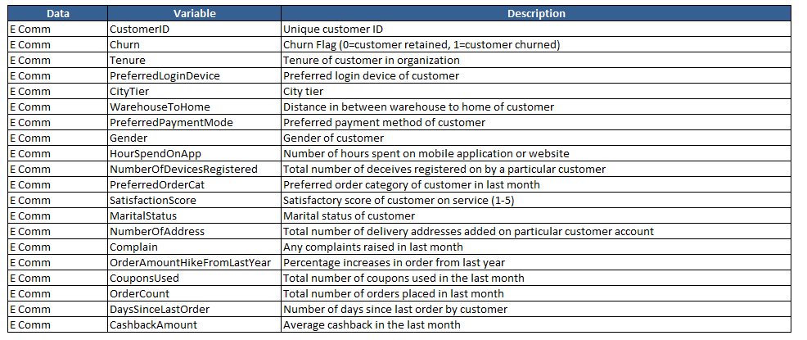
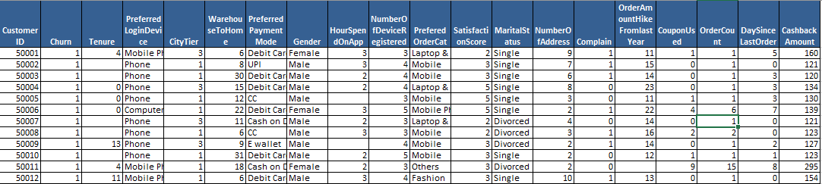
Shape (5630, 20)
Source:
Kaggle
Notes:
We sourced our data from Kaggle. Here is a quick glance at the data description and the first few observations of the data
It has 5630 observations and a total of 20 columns (19 features and 1 binary target variable)
It contains integers, floats and object variable types

Slide 12
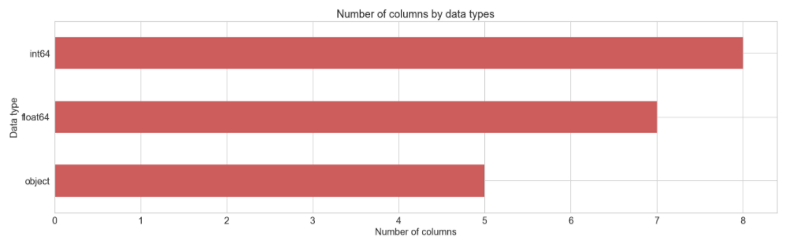
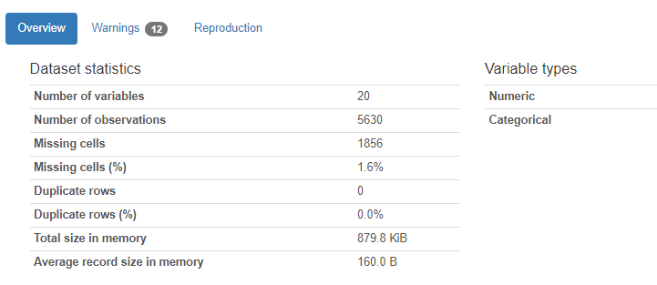
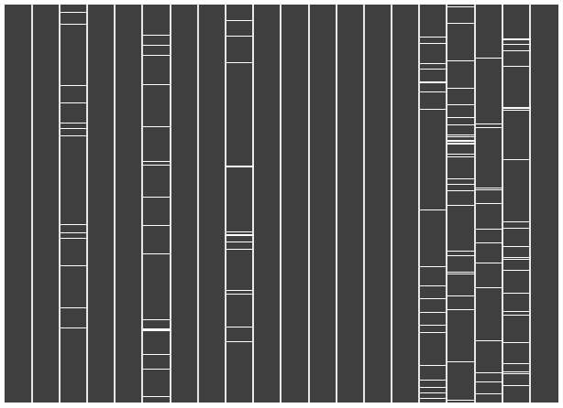
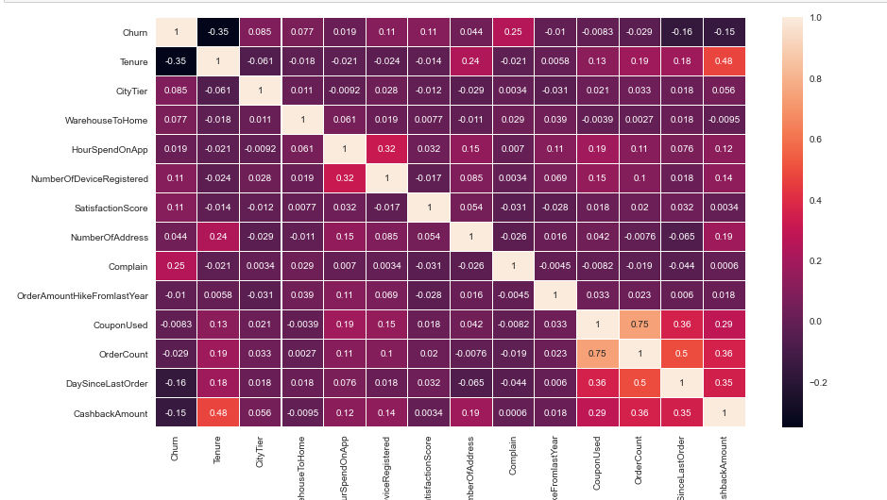
Data exploration
Data types
Pandas profiling
Missing values
correlation
Notes:
During the data exploration phase, we did
- Pandas Profiling
- Identified the number of different data types
- Counted how many missing values there are in the data set and visualized it
- We also looked at the correlation between the target variable and all other features, and there was no multicollinearity.

Slide 13
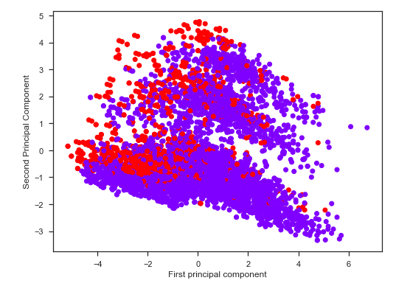
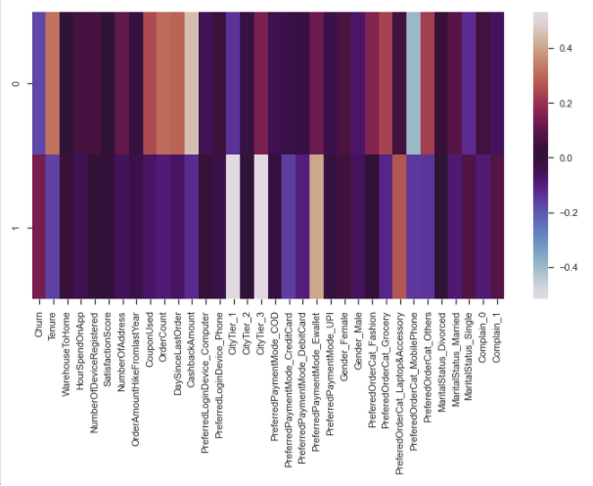
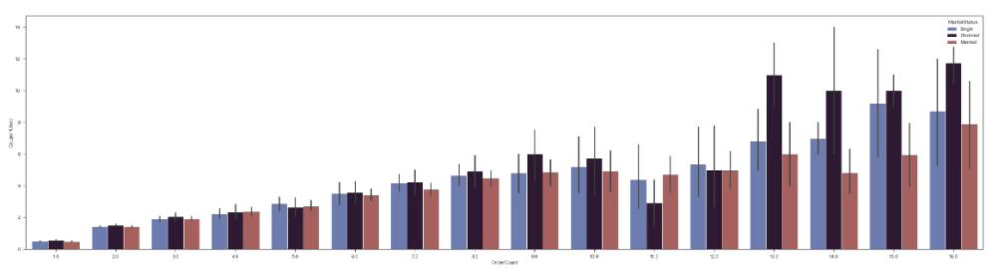
Data exploration
PCA
Coupons vs ordercount per marital status
Notes:
We initially performed PCA to better understand the interaction between our variables. The graph on the right of the clusters shows the contribution of each variable to each principal component (1 and 2).
Due to difficult interpretability of unsupervised learning techniques, we also did quite a lot of univariate and multivariate analysis to explore relationships between variables. The graph below shows one of the examples of the types of insights we were able to obtain: it shows that as the number of orders increases, so does the number of coupons used. And divorced customers use the most coupons than single and married customers.

Slide 14
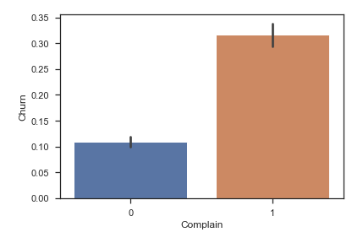
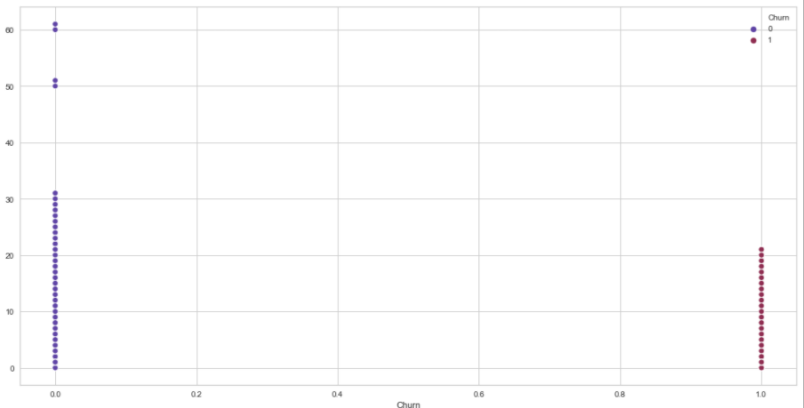
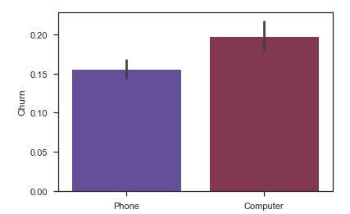
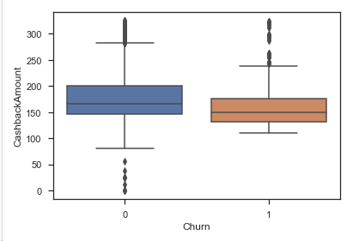
Insights (verification of hypotheses)
tenure
complain
Cashback amount
Access by phone
Notes:
We used these Univariate and Multi-variate analyses to test our hypotheses
- Our hypothesis about the tenure was correct. we see that those who churn (line on the right) usually have a lower tenure, than those who are retained
We were also correct about the Complain variable. Customers who complain are more likely to churn.
Also correct about CashbackAmount – customers who churn receive slightly less cashback.
Similarly with the login device variable, customers who access the platform via phone are less likely to churn.
So just by intuition, we can derive some of these insights, but the data exploration process helps validate them. Of course, these are just correlations, and more analysis needs to be done to conclude if these differences are actually significant.

Slide 15
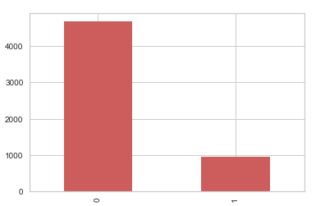
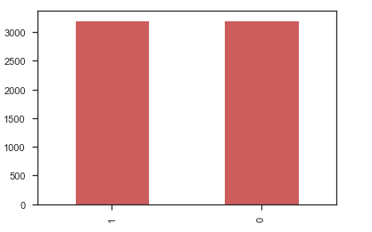
Data pre-processing
70%
Pre-process
Selection
Training set
N = 3941
- Simpleimputer (median)
- One-hot encoding
- Clean columns
- Correlations
- Outlier treatment
- Feature selection
- Standardization
- Random over sampling (n=6428)
Model building
- precision
- *Accuracy
- Recall
- F1 score
- *Auc roc
tuniing
- randomsearchcv
- Feature importance
- Dummyclassifier
- Logistic regression
- Random forest
- Knn
- Xgboost
- Adaboost
- Catboost
- ANN
Company data
Test model
- Accuracy: 0.96
- AUC-ROC: 0.92
VAL set
N = 845
15%
Pre-process
- pipeline
15%
Test set
N = 844
Pre-process
- pipeline
Notes:
Next, we moved on to Data Pre-Processing.
Split the data into train and test (70-30), then further split the test into Validation and Test sets
Using the training data only, we preprocessed by imputing with the median for the numerical variables that had missing values, one-hot encoding of the categorical variables, cleaning the column names, doing correlations again and we noticed that some of the dummified categories were correlated so we removed those. Performed outlier treatment to remove outliers, standardized and then using ROS to deal with imbalance data.
Then we created a processing pipeline for the val data with all these techniques except outlier treatment and ROS
Then we used the train and val set to build and validate 8 different models. We then compared their scores – mainly accuracy and AUC-ROC to choose the best performing model. Then we tuned the best model using RandomSearchCV and also found the feature importances. Then we created a full pipeline to process and model the test data. We then tested the model and got an accuracy score of 0.96 and auc or 0.92

Slide 16
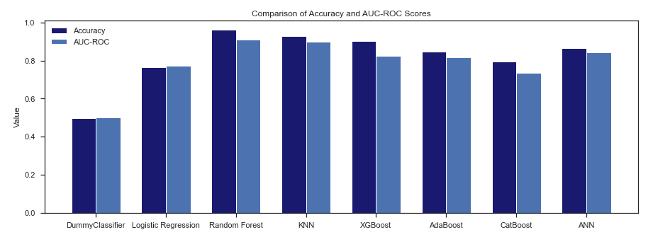
modelling
Comparison of accuracy and auc-roc scores
Notes:
As previously mentioned, here is our comparison of the accuracy and auc-roc scores. Random Forest was the best performing model.

Slide 17
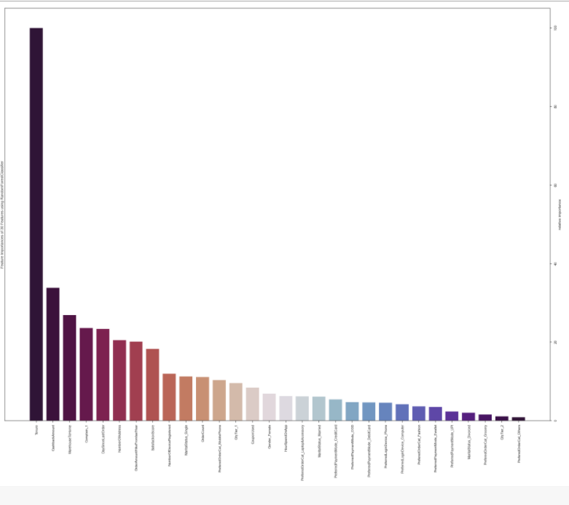
modelling
Feature importance
TOP 5 FEATURES:
Tenure
CashbackAmount
WarehouseToHome
Complain
DaysSinceLastOrder
Notes:
The feature importance plot also helped up validate our hypotheses. The top 5 features were [READ SLIDE], and we had hypothesized that tenue, cashback and complain were the top features.

Slide 18
04
Results & conclusion

Slide 19


Use case
Customer 1
Customer 2
Gender: Female
Login: Mobile Phone
Payment: E-Wallet
Marital Status: Divorced
CityTier: 3
Complain: 0
Cashback Amount: $160
Hike from last year: 14%
Hours on App: 2
CHURN
Gender: Male
Login: Mobile Phone
Payment: Credit Card
Marital Status: Divorced
CityTier: 1
Complain: 1
Cashback Amount: $159
Hike from last year: 13%
Hours on App: 2
RETAIN
Notes:
So using our predictive model, the e-commerce company is able to feed in data pertaining to customer attributes, and get a churn prediction classification.

Slide 20
Threats to validity
Small data size and imbalanced data | Data collection and limited variables | Conclusion validity | uncertainties
Training data had 3941 observations | Unaware of data collection process. Time-series data would have been beneficial | Need to statistically validate results from hypothesis tests | Exogeneous shocks (unforeseen events)
Collect more data Be aware of imbalance data | Selection Bias could be present (CityTier 3) Would be valuable to capture time series data to evaluate the fluctuations of customer behavior over time | In addition to the exploratory data task, it is important to conduct statistical analysis to accept or refute the hypotheses | Collect data from a wider time period to capture some market fluctuations and flexibility in user behaviour
Notes:
Selection bias – very small number of people in CityTier performed transactions in the last month. But that could not always be the case. So this is why time series data would have been helpful to capture and evaluate the fluctuations in customer behaviour over time, rather than just

Slide 21
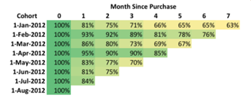
recommendations
Business/finance | Marketing team | Data scientists | Product team
Customer Churn → Revenue Churn. Understand spend ($) per customer. Cost of retention for some customers may be less than the cost of acquisition of others. | Target ‘at-risk’ customers. Use direct outreach, retention campaigns, discounts, loyalty programs and special offers to reel them back into your funnel. | Classification → Regression. Instead of an absolute classification of churn, view it more as a scale [proba], and evaluate the health of the shopper | A/B Testing. Improve features on the laptop UI to reduce churn
Improve Customer Service Team. Most people gave a rating of 3 | Customer Segmentation. High churn in CityTier3 and with Single customers. | Do deeper analysis with clustering models | Remove Cash-On-Delivery option, as this leads to the high churn.
 | Customer Survey to understand reason behind customer churn: incidental vs deliberate churn | Cohort Analysis – observe changes in the same group of customers who joined at the same time to see how long it takes on average to churn
Notes:
A churn model can be a key part of a business strategy, but alone it will not be enough. The e-commerce company needs to take the time to not simply predict churn but truly understand why it is occurring, and design strategies to address it.

Slide 22
Lessons learned
Next steps
Importance of data pre-processing
New visualization techniques
How to identify best machine learning model
Learned to perform different roles [project manager, data/business analyst, etc..]
Get a more encompassing time-series dataset that is more representative
Get industry specific data to find industry specific trends and patterns
Get customer feedback to gain a more in-depth analysis
Cohort Analysis
Customer Lifetime Value Analysis
Causal Inference

Slide 23
THANKS!
https://github.com/McGill-MMA-EnterpriseAnalytics/Churn-Analysis

